Slide 1
Data Pipeline Architecture : From Extraction to Processed Storage
*

Slide 2
Data Pipeline Diagram
‘
Relational DB
Data Extraction
Data Cleaning
Final Storage
Feature Engineering
Data Normalization
Monitoring

Slide 3
Explanation of Diagram
Data Extraction: It is the first step in which data is extracted from a relational database, such as MySQL or PostgreSQL. Data shall be fetched via SQL queries or ETL-Extract, Transform, Load tools like Apache Airflow, Talend, and custom scripts.
Data Transformation: It is that step of the process where raw data is changed into an analyzable format. It includes a number of processes
Data Cleaning: It removes duplicates, sorts missing values, and corrects any erroneous records.
Normalization: The process of scaling numeric variables in one common range, such as 0 to 1 or z score, to make them all uniformly comparable across features.
Feature Engineering: Inventing new features from domain knowledge, for example, data aggregation, given that daily sales would create a feature "monthly sales".
Final Storage: The cleaned and enriched data, after transformations, will be stored in appropriate formats for further processing or model training. More common options include
●Parquet Files: Chosen for its columnar storage, which provides efficient read and write access, especially for large datasets.
●Feature Store: In the case of preparing data for machine learning, the features can be stored and maintained in a centralized repository called a feature store.

Slide 4
Pipeline Type
Batch Processing: Batch processing involves gathering data over a period of time-such as daily or weekly-and then handling it together as a batch. This is in contrast to the streaming pipelines that process data in real time as it arrives. In general, batch processing applies when data does not need to be updated on a constant basis, or there is no immediate need for real-time insight.
Justification
● Cost Efficiency: Batch processing is usually less expensive, especially when large volumes of data are involved and real-time processing is not necessary. Instead of using resources to process data continuously, batch processing means that data is processed in bulk at periodic intervals, such as during nighttime hours. This means that at any one time, fewer system resources are being used, thus reducing costs.
● Large Volume of Historical Data: In case you have large historical data, such as customer behavior logs or sales data, it would be ideal to process them in smaller periodic batches. It will enable you to perform transformations such as cleaning, aggregation, and normalization on datasets that are too large to handle efficiently in real time.
● Scheduled Data Processing: As most of the business processes don't need immediate updates, like sales reports, inventory updates, processing of data at intervals such as daily or weekly aligns well with the business cycle. It thus enables your team to process data in off-peak hours, say at night, when system load is generally low.

Slide 5
Data Format
Parquet : Parquet is a very efficient, columnar storage format, tailored for high performance in data analytics. Native support for compression and schema evolution makes it perfectly suitable for big datasets that must be queried column-wise. The Parquet file format can also be used in big data frameworks like Apache Spark or Apache Hive, making processing of large amounts of data easily possible in batch processing pipelines.
Advantages
● Efficiency: Parquet is optimized for both reading and writing large datasets.
● Saving Space: Because it is compressed and columnar, Parquet decreases storage costs compared to row-based formats such as CSV.
● Schema Support: It allows for schema evolution, which can handle changes without breaking the pipeline if new columns are added.

Slide 6
Data Quality
Data quality is important in every ML pipeline, giving it a strong percentage of whether this model would give an accurate, reliable, or fair prediction. Poor quality data-missing values, duplicates, and outliers-could be biased and incorrect, leading to undermining the effectiveness of a model and ultimately eroding trust in the system. For example, missing data creates biased predictions unless its handling is appropriate, while duplicates can over-emphasize some pattern and outliers have the capability to disproportionately influence the learning process of a model. Ensuring the data is clean, consistent, and representative before it goes for model training is important because costly mistakes and misleading results might be obtained otherwise.
Quality data would be assured if there was strong validation and monitoring spread across a pipeline. This will include missing value checks, duplicate checks, and outlier checks before data processing, imputation, de-duplication, or removal of outliers where needed. Continuous monitoring to find concept drift or schema changes in incoming data over time will be necessary for the model to stay put. With early detection of data quality issues and regular validation and cleaning of the data, companies can build more accurate and trustworthy ML models, make better decisions, and reduce the risk of financial or operational setbacks.

Slide 7
Data Quality Issue 1: Missing Values
Missing values are one of the most common problems in datasets. It can occur due to various reasons such as data entry errors, system failures, or incomplete data collection. If not treated properly, missing values can affect the performance of the model. For instance, missing customer data in a sales dataset may lead to incorrect sales predictions.
How to Handle Missing Values:
Validation
●We should check for any missing values before feeding the data into the model using functions like pandas.isnull() or pandas.isna() in Python.
●There are checks for missing values in all key columns, for example, customer ID and sales amount. Check what the percentage is with regard to that. Those kinds of features should be imputed or dropped if containing more than 30% missing values.
Monitoring
●Continuous monitoring for missing values as the data is streaming into the pipeline. Automated alerts in case the percent missing is above a threshold of say 5%.
●Tools: The monitoring tasks regarding missing values could be scheduled with Apache Airflow or AWS Glue to trigger an alert in case the threshold is exceeded.

Slide 8
Data Quality Issue 2: Duplicates
Another common data quality issue that might distort the analysis is duplicate records. Duplicates can occur due to improper data merging or as a result of human error during data entry. Duplicate sales transactions of the same customer, for example, may distort revenue analysis.
How to Handle Duplicates
Validation
● Verify for duplicates by confirming key columns such as transaction ID or customer ID using pandas.duplicated() in Python.
● Validation Check: Add validation that checks a new row for an exact or near-duplicate compared to existing data, such as same customer and transaction amount etc.
Monitoring
● Automate the monitoring that will be scheduled at regular intervals to check for duplication. Alerts can then be triggered based on threshold exceedance-say, for example, when it is over 1% of the data count.
● Tools: Utilize ETL monitoring tools to monitor for duplicate occurrences; set up notifications.

Slide 9
Data Quality Issue 3: Outliers
An outlier is a value that is considerably different from most of the data. It may be a legitimate extreme value or an error in recording. These are apt to skew all of the statistical analysis or model training. For example, a few very extreme values in a customer's spending would cause a shift in a revenue prediction model.
How to Handle Outliers
Validation
● Uncover the anomalies in a dataset with the use of statistical methods like Z-score or IQR. Use libraries like scipy.stats.zscore() or pandas.describe() to identify extreme values in Python.
● Validation Check: Provide a check that will highlight data points falling outside a predetermined threshold; for example, points with a Z-score greater than 3 or below -3.Monitoring
Monitoring
● Continuously monitor for outliers in newly ingested data. Especially critical features are transaction amounts or customer ages. Alerts shall be triggered in cases when the occurrence of outliers is higher than, for example, 2% of the dataset.
● Tools: In the case of streaming data handled by your data pipeline, implement real-time anomaly detection using Apache Kafka or AWS Kinesis.

Slide 10
Validation and Monitoring
The process of validation and monitoring should be continuous and automated to catch data quality issues as soon as they arise. Here’s a quick overview of our strategy for handling missing values, duplicates, and outliers.
Validation
● The key fields need to be validated, such as missing values, duplicate data, outlier detection. Define threshold values for the various validation checks, for example, missing value count > 5%, duplicate count > 1%, outliers more than ±3 standard deviation from mean.
Monitoring
● Monitoring jobs are created using open-source tools like Apache Airflow. Periodic monitoring checks the data at regular, predefined time intervals. Alerts should be triggered if any of the data quality checks exceed their set thresholds.

Slide 11
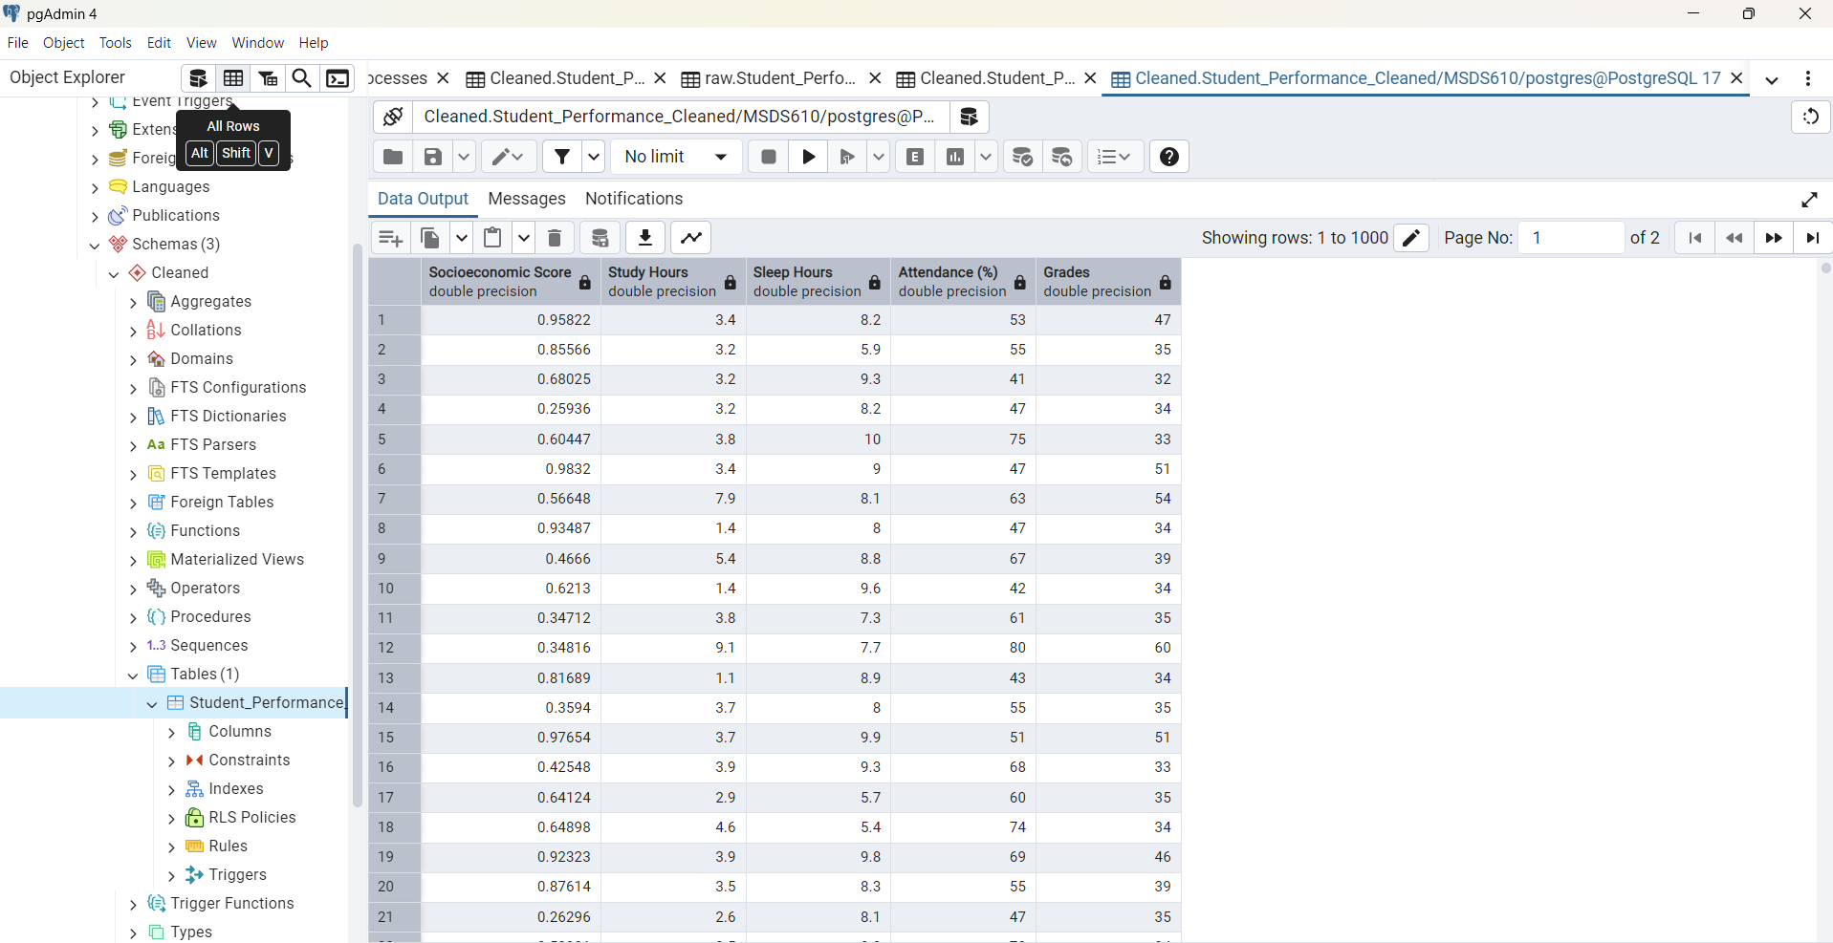
Screenshot of Database

